Slide 1
EDUCATION
MAINTENANCE
ALLOWANCE
A introduction to EMA
(Education Maintenance Allowance)
*All information is based on academic year 24/25 and may be subject to change in future years.
www.nidirect.gov.uk
For full information and terms and conditions see website guidance and documents

Slide 2
EDUCATION
MAINTENANCE
ALLOWANCE
EMA
What Is EMA?
Should I apply ?
Household income ?
How much could I get ?
How to apply ?
What happens next?
References relate to “The little book of EMA for academic year 2024/25
www.nidirect.gov.uk
For full information and terms and conditions see website guidance and documents

Slide 3
EDUCATION
MAINTENANCE
ALLOWANCE
What is EMA?
Education Maintenance Allowance is a weekly allowance of £30 to help 16, 17, 18 and 19 year olds with the costs of further education.
Payments are made every 2 weeks as long as you continue to meet your school or college’s attendance requirements.
There are also 2 performance based bonuses of £100 normally paid out in January and June
www.nidirect.gov.uk
For full information and terms and conditions see website guidance and documents

Slide 4
EDUCATION
MAINTENANCE
ALLOWANCE
Should I apply?
You need to meet the following requirements to be able to get EMA:
Age - Your 16th, 17th, 18th or 19th birthday falls on or between 2 July 2023 and 1 July 2024 and you are starting or continuing in further education from September 2024.
Course - You attend a post-compulsory further education course at an approved school or college in Northern Ireland. This must be full-time at school or a minimum of 15 guided hours per week at college, studying an eligible course and attending all classes.
Nationality and residency If you’re a UK citizen who normally lives in the UK you should be able to get EMA. If you’re not a UK citizen you may still be able to get EMA, go to www.nidirect.gov.uk for more information.
Household income – see table on next slide
www.nidirect.gov.uk
For full information and terms and conditions see website guidance and documents

Slide 5
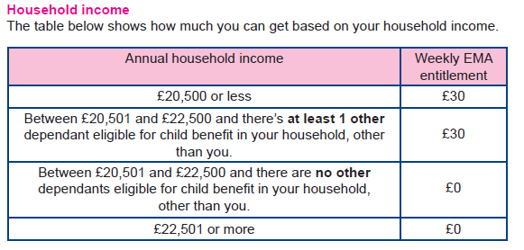
EDUCATION
MAINTENANCE
ALLOWANCE
How much could I get ?
You won’t be able to get EMA if you’ve been approved to receive a
Department of Agriculture, Environment and Rural Affairs (DAERA) Bursary or
a Department for the Economy Further Education Award for the course you’re
applying for.
www.nidirect.gov.uk
For full information and terms and conditions see website guidance and documents

Slide 6
EDUCATION
MAINTENANCE
ALLOWANCE
When and how to apply ?
You need to complete an application form.
You’ll be able to get one from:
your school or college
www.nidirect.gov.uk
Application forms will be available from spring. You should return your application form as soon as possible.
www.nidirect.gov.uk
For full information and terms and conditions see website guidance and documents

Slide 7
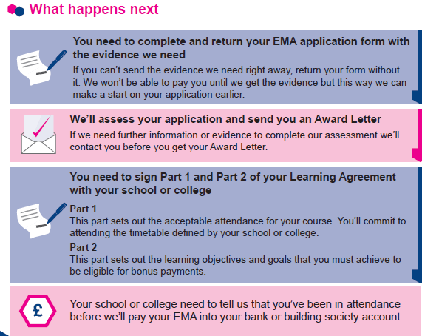
EDUCATION
MAINTENANCE
ALLOWANCE
www.nidirect.gov.uk
For full information and terms and conditions see website guidance and documents

